Slide 1


The Agricultural Micro-Loan Crisis
Empowering Kenyan Farmers with Data-Driven Decision
What problem? Kenyan microfinance institutions and SACCOs face severe financial risk from agricultural loan defaults.
Who does it affect? It impacts financial institutions via lost liquidity and smallholder farmers via tighter credit standards.
Why does it matter now? Agricultural lending is highly volatile due to climate risks, and manual assessments are too slow and biased to manage this effectively.
~21.8% of agricultural loans default, creating significant financial losses and operational strain for SACCOs.

Slide 2
Data & Modeling Approach
Dataset: A relational dataset combining applicant demographics, historical loan records, and current loan performance from a Kenyan micro-lender.
Observations: The core performance dataset contains 4,368 distinct loan records.
The Model: A tuned XGBoost ensemble was selected because gradient boosting excels at capturing complex, non-linear relationships within structured tabular data.
The Baseline: A PyTorch ShallowMLP neural network (alongside DeepTabNet) served as the benchmark for evaluating the XGBoost model's predictive power.

Slide 3
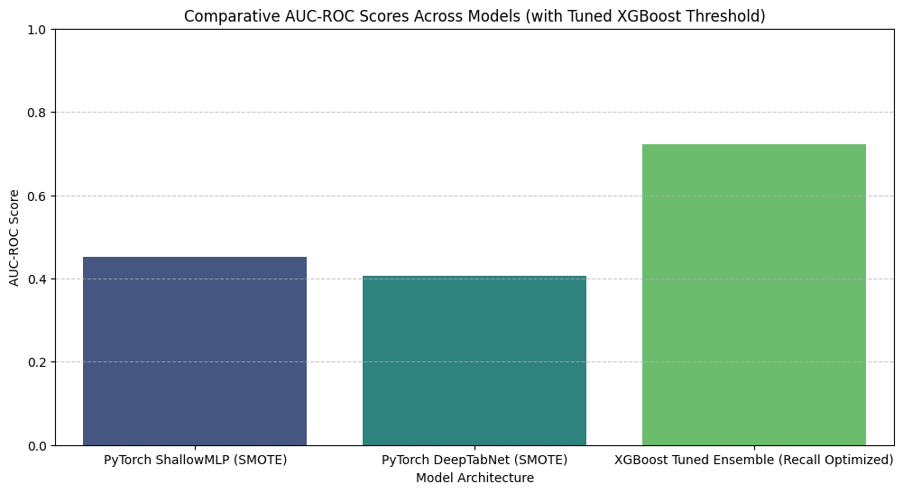
Performance Results
Primary Metric: Default Recall (maximizing the identification of high-risk loans).
Secondary Metrics: AUC-ROC and F1-Score to balance overall performance.
Comparison: The tuned XGBoost model significantly outperformed the neural network baselines.
Employment Status | Sample Size | AUC-ROC
Permanent | 250 | 0.745
Self-Employed | 410 | 0.720
Student | 85 | 0.715
Unemployed | 110 | 0.705
Retired | 19 | 0.68

Slide 4
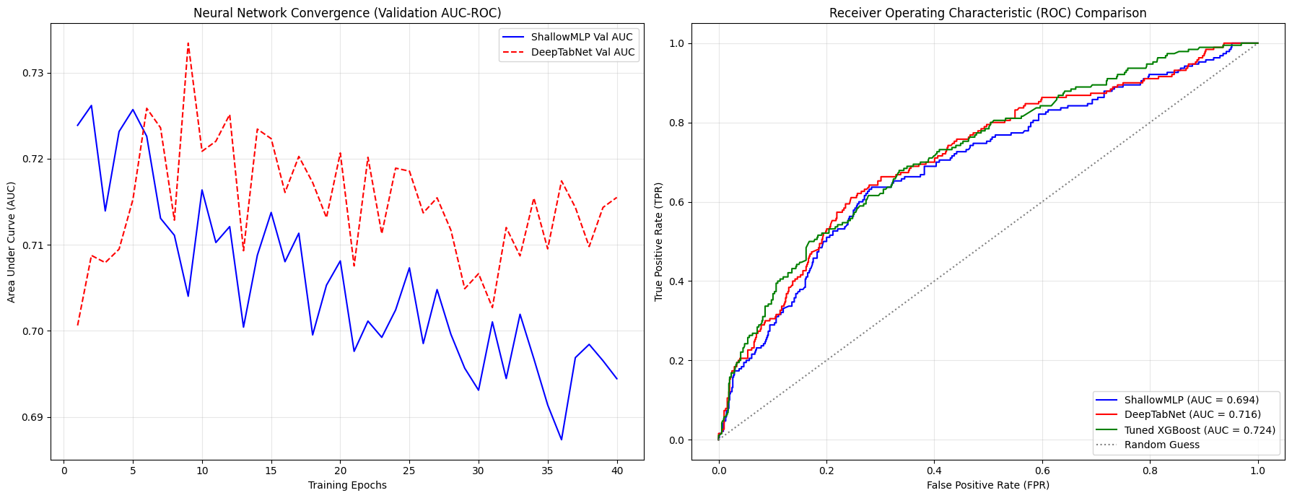

Slide 5
Responsible AI & Limitations
Model Limits: This system is strictly an advisory tool; it cannot replace human judgment or foresee sudden real-world shocks like severe droughts or floods.
Potential Harm: Vulnerable smallholder farmers face severe financial exclusion if the algorithm systematically over-predicts defaults (false positives).
Fairness Criterion: A disaggregated AUC-ROC analysis was applied across employment subgroups to verify consistent performance and audit for algorithmic bias.
Significant Limitation: The model relies entirely on historical tabular data; addressing this requires integrating live climatic data and enforcing a human-in-the-loop review process.

Slide 6
Conclusions & Next Steps
Finding 1: Engineered behavioral features, such as repayment delay ratios, provided far stronger predictive signals than raw demographic data alone.
Finding 2: Adjusting the classification threshold was significantly more effective at catching actual loan defaults than relying solely on SMOTE data augmentation.
Finding 3: The gradient-boosted XGBoost architecture consistently outperformed deep neural networks on this specific structured tabular dataset.
Next Step: Partner with a Kenyan agricultural SACCO to deploy the model in a controlled pilot, actively tracking the human override rate to continually refine the system.

